Slide 1
3D computer vision techniques

Slide 2
3D computer vision techniques.
Abstract In this talk, the ideas of obtaining 3D information of objects (or called 3D reconstruction) using different techniques are discussed. Currently, the most popular one is the image based method that uses 2D cameras for 3D reconstruction; in particular reconstruction based on one-image, two-image and multiple-image are discussed. Moreover, batch and sequential treatments of input data are studied. I will also talk about novel techniques, such as using multiple cameras and laser based methods to obtain 3D information. And I will discuss how 3D computer vision is used in film and game production. Finally naked-eye 3D display technologies will be mentioned.

Slide 3
Motivation
We live in a 3D world
We see 2D images but perceive the world in 3D
Intelligent robot should have this 3D reconstruction capability

Slide 4
How to obtain 3D information?
Cameras-2D
Range sensors-3D

Slide 5
Challenges
Obtain 3D information for tasks in a 3D world.
2D-to-3D reconstruction from a camera
3D directly— laser range sensor, kinect sensor
Novel sensors
Camera array/ multiple camera
One pixel camera
light field camera

Slide 6
2D-to-3D reconstruction (feature based method)
Camera (perspective projection)
Features-extraction and correspondences
Methods
One-image method
Two-image (Stereo) method
Three-image method
N-image method
Bundle adjustment
Kalman filter

Slide 7
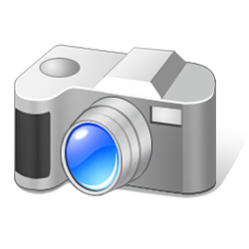
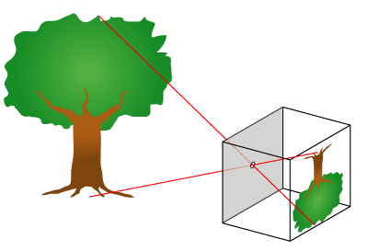
Camera: 3D to 2D projection
http://upload.wikimedia.org/wikipedia/en/8/81/Pinhole-camera.png
Pinhole
Camera
Perspective model
u=F*X/Z (nonlinear relation)
v=F*Y/Z
Virtual
Screen
or CCD
sensor
World
center
Y
v
F
Z
F
Real
Screen
Or
CCD
sensor
Thin lens
or a pin hole

Slide 8
Perspective Projective
World
Coordinates
Zw
Yw
Xw
Rc,Tc
Model M at t=1
v-axis
image
X,Y,Z
Xc-axis
Camera
Coordinates.
(u,v)
Zc-axis
Principal axis
O_{c}=
(0,0,0)
(Camera center)
c (Image center, o_{x},o_{y})
u-axis
F=focal length
Yc-axis
(0,0) of image plane

Slide 9
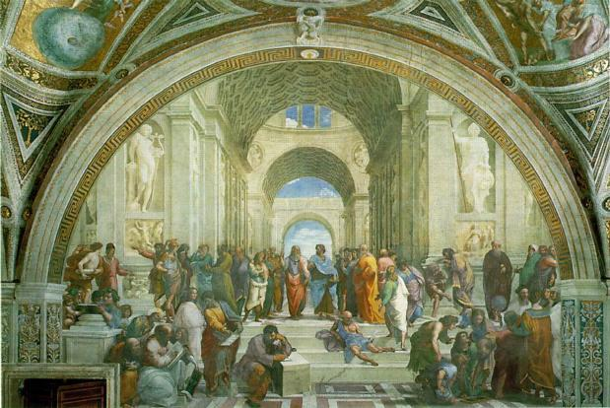
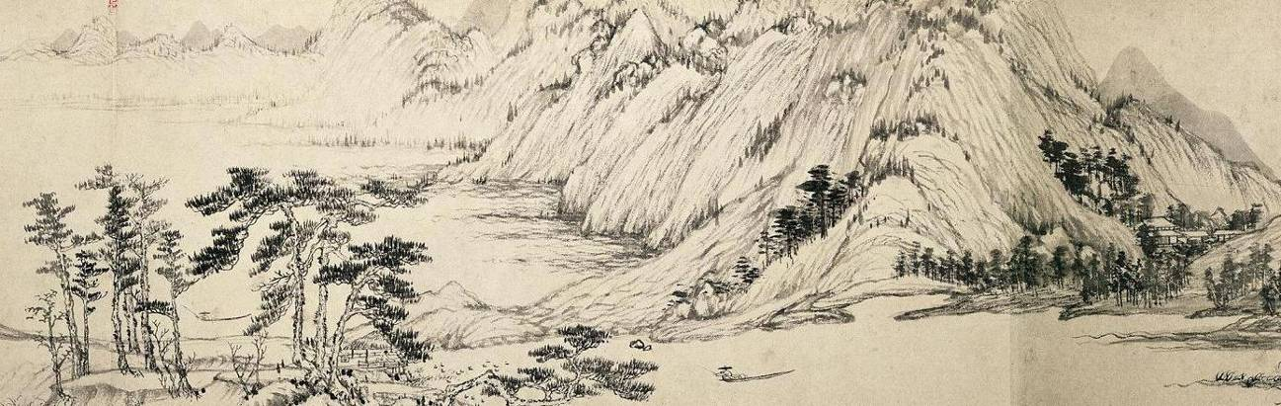
In paintings
Western
Fresco by Raphael, 1510 - 1511, Stanza della Signatura, Vatican Palace, Rome.
Chinese
《富春山居圖》是元朝》是元朝畫家黃公望的作品，創作於1347年至1350年
Dwelling in the Fuchun Mountains (富春山居圖) by Huang Gongwang (1269–1354)
http://www.es.flinders.edu.au/~mattom/science+society/lectures/illustrations/lecture17/schoolathens.html
http://jsl641124.blog.163.com/blog/static/17702514320115219508530/

Slide 10
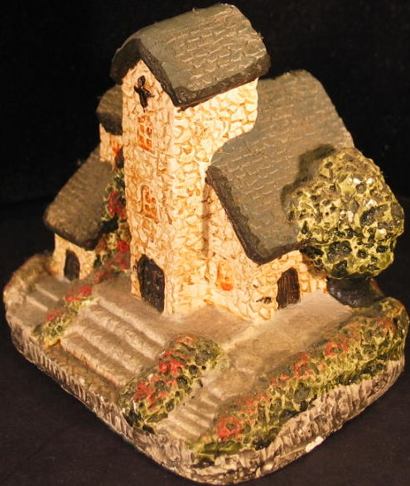
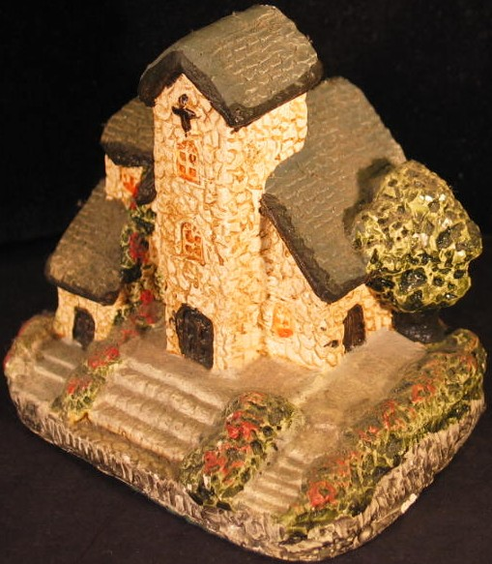
Feature correspondences --Camera moved, find correspondences for neighboring images --We can use feature to identify the motions of projected 3D features in 2D.
Area a
Image at t=t₀
(or left image)
Image at t=t₀+dt
(or right image)

Slide 11
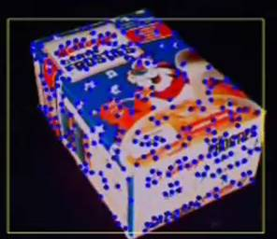
Demo
Youtube Movie
http://www.youtube.com/watch?v=azl-DGK6e1U

Slide 12
One-image
2D-to-3D reconstruction

Slide 13
One image 2D-to-3D reconstruction method
Difficult and with ambiguity
http://ai.stanford.edu/~asaxena/reconstruction3d/

Slide 14
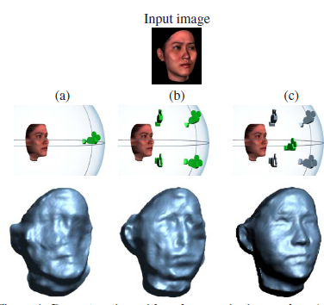
One image 2D-to-3D
Using prior knowledge (e.g. face)
http://www.wisdom.weizmann.ac.il/~ronen/papers/
Hassner Basri - Example Based 3D Reconstruction from Single 2D Images.pdf

Slide 15
Two-image
2D-to-3D reconstruction

Slide 16


Two-image 2D-to-3D reconstruction method: stereo vision
Objectives:
Basic idea of stereo vision
Stereo reconstruction by epipolar geometry
Stereo camera pair calibration (find Fundamental matrix F)
Construct the 3D (graphic) model from 2 images
Inside a computer
Graphic
model

Slide 17
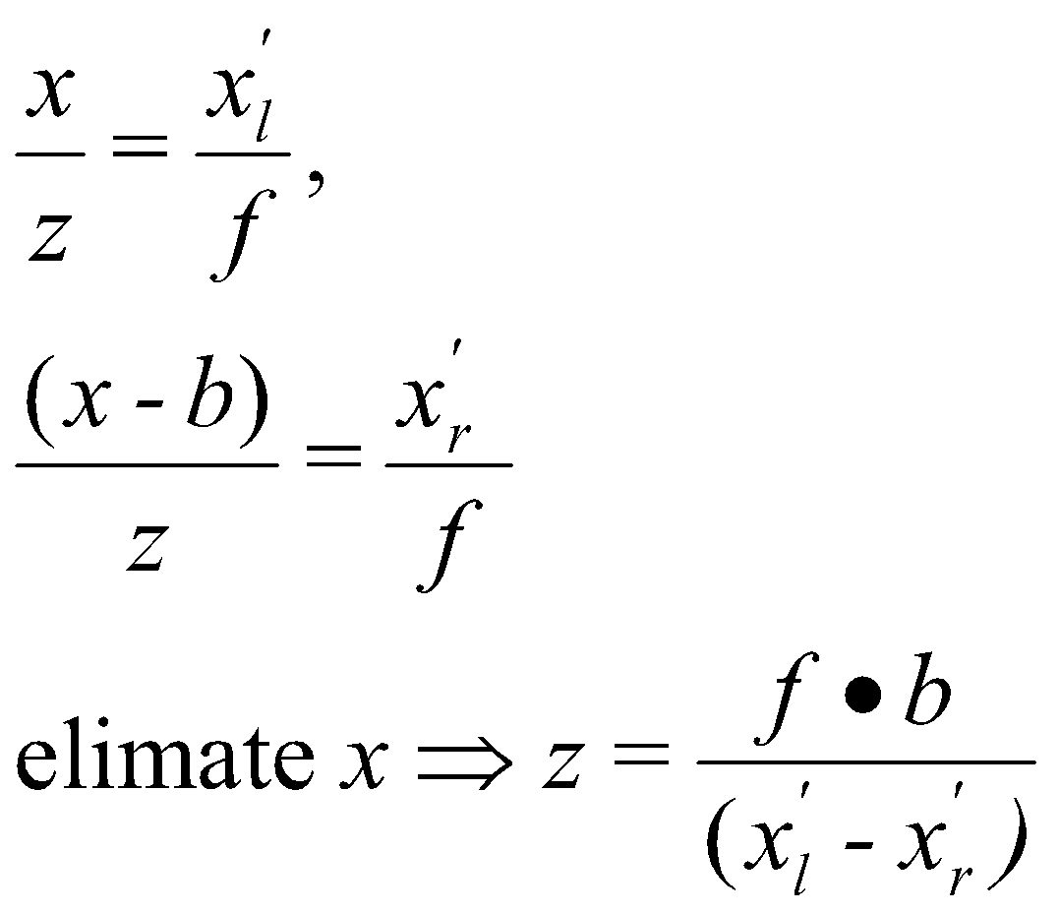
if camera motion is pure translation
: Triangular calculation
Left
Camera
Principle
axis
Right
Camera
Principle
axis
Object
Px(x,y,z)
By similar triangle,
w.r.t left camera lens center
z
Left
Image
plane
Right
Image
plane
X’_{l}
X’_{r}
Focal
Length
f
b (Baseline)
By similar triangle,
w.r.t right camera lens center
Left camera center
(reference point)
Horizontal
Disparity=x_{L}-x_{R}
One major problem is to locate x’l and x’r The correspondence problem

Slide 18
If camera motion is NOT pure translation : Use Epipolar Geometry
X
Right_image_pointT*E*left_image_point=0
Left side is the reference
Plane-3 ∏₃
Perpendicular to
T×X₂ or T×X₁
(x₂,y₂)
Right epipolar line
Left epipolar line
(x₁,y₁)
left
Frame
Plane-1 ∏₁
right Frame
Plane-2 ∏₂
O₂
O₁
e₁
e₂
R,T
Focal
length=f₁
Base line=||T||
Focal
length=f₂

Slide 19
Method: 8-point algorithm http://www.cs.manchester.ac.uk/ugt/COMP37111/papers/Hartley.pdf
Find 8 point corresponded (
Map 8 Right_image_points to left_image_point
Solve the epeiolar formula
Right_image_pointT*E*left_image_point=0
Find E.
From E we can find camera R (rotation) ,T (translation)
From R,T we can find model (3D positions of the left feature points (using left as reference)

Slide 20
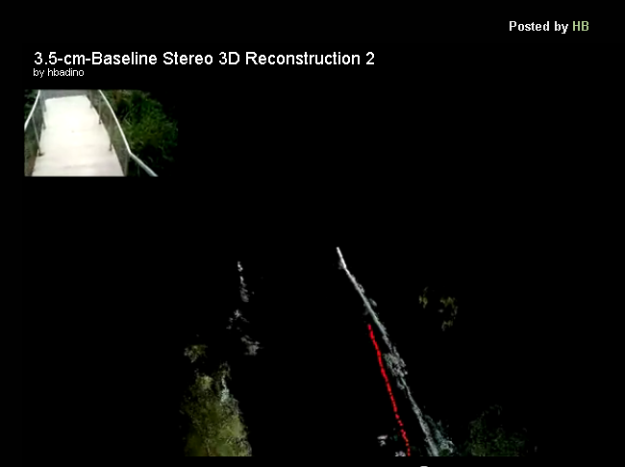
An example of stereo reconstruction
An example
Short-Baseline Stereo Systems for Mobile Devices
http://www.lelaps.de/videos.html#SQx5vU8BA-M
http://www.lelaps.de/projects/stmobile.html

Slide 21
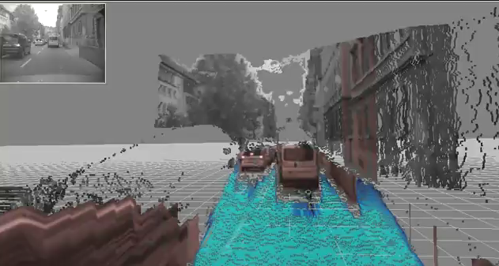
Stereo-based Free-space Estimation
Another example
http://www.lelaps.de/videos.html#VrKBNtAN03o
http://www.lelaps.de/projects/freespace.html

Slide 22
Three-image
2D-to-3D reconstruction

Slide 23
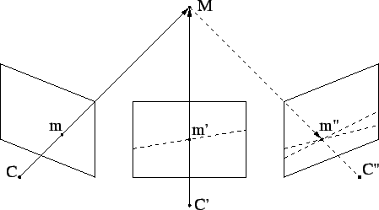
Three-image 2D-to-3D reconstruction method
More robust using 3 views
It contains 3 epipolar relations
Stereo1: view1,2 ,
Stereo2: view2,3,
Stereo3 :view 3,1.
Combine 3 epipolar geometry information together.
Similar to the algorithm in epipolar geometry (apply 3 times)
M=3-D model point
M, m’, m” are image points
C,C’,C” are camera centers
http://www.cs.unc.edu/~marc/tutorial/node45.html

Slide 24
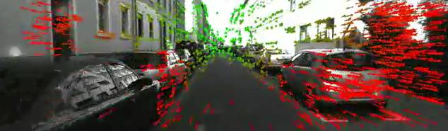
Example of 3-image reconstruction
Example
LIBVISO: Feature Matching for Visual Odometry
http://www.youtube.com/watch?v=DPLh6MoxPAk

Slide 25
N-image
2D-to-3D reconstruction
(batched method: order of images can be random )

Slide 26
N-image 2D-to-3D reconstruction method
Bundle adjustment approach
Guess iteratively the solution for 3D to explain the measurements of feature points in all images
Math: Q(u,v)=g(X), g is nonlinear (projection) because
u=fX/Z
v=fY/Z, f=focal length
Given Q (image measurement) , we want to find X=(X,Y,Z)_{i} from image points (u,v)_{i} of all N model points (i=1,,,N), g is the projection formulas
A typical non linear optimization problem,
Gauss-Newton for non linear optimization method is used.

Slide 27
Batched method: order of images can be random
From measurement [u,v]I find X
X
v1
[u,v]1
v2
[u,v]2
v3
vm
O1
Image
t=1
[u,v]3
R1,T1
…
[u,v]m
…
Image
t=2
O2
Image
t=3
Image
t=m
Om
Rm,Tm
R2,T2
O3
R3,T3
Camera motion

Slide 28
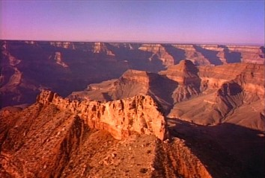
Example
Bundle adjustment reconstruction
http://www.cse.cuhk.edu.hk/%7Ekhwong/demo/canyon2b2.mpg

